Slide 1
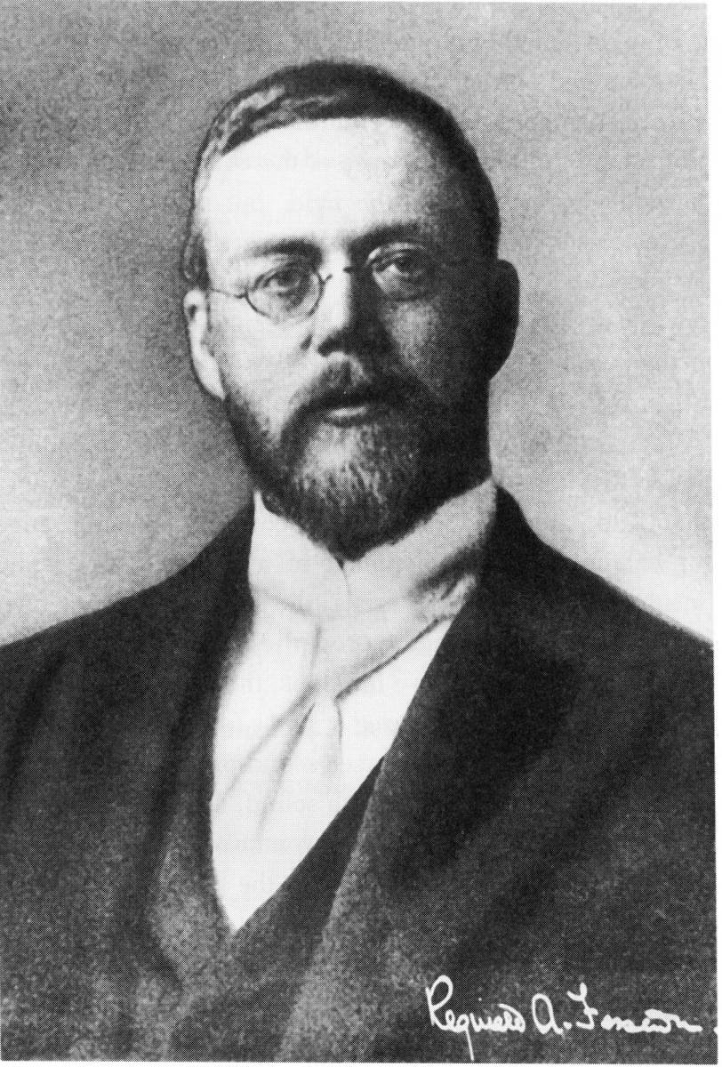
The Father of Radio Broadcasting
Reginald Fessenden
First two-way Transatlantic radio telegraph (spark) 1906
Pioneered Continuous-Wave Transmission and Heterodyne Reception.
Alexanderson Alternator
First Credible Voice Broadcasts - 1906
Reginald Aubrey Fessenden
(1866-1932)

Slide 2
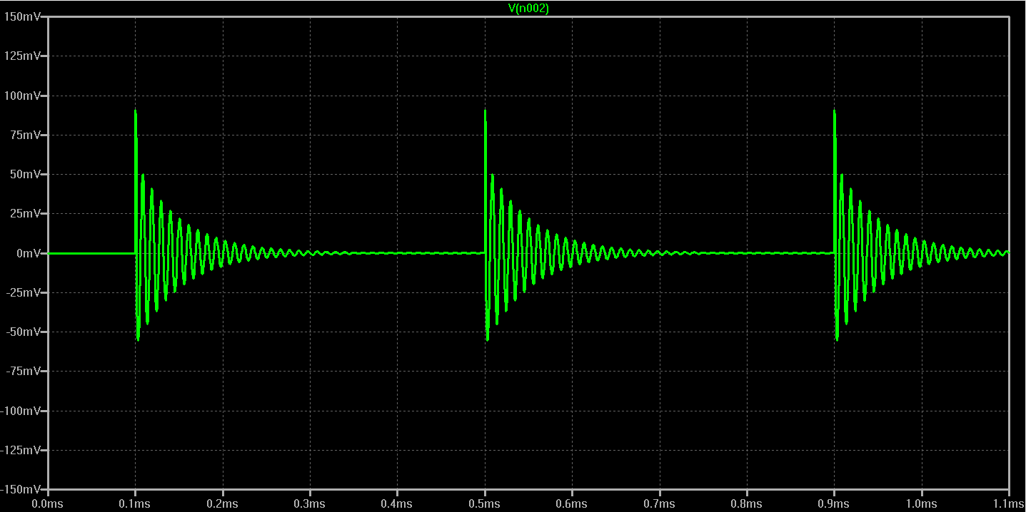
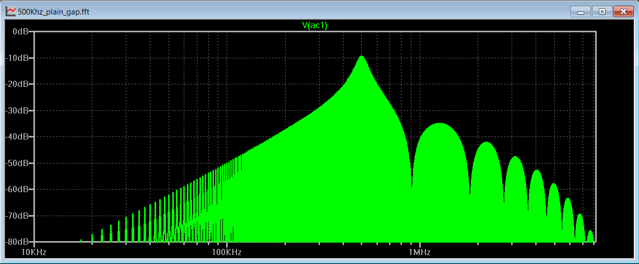
Damped Waves:
Produced by spark-gap transmitters.
Each spark discharge causes the RF tuned circuit to ring like a bell or plucked string.
Each pulse dies away.
The carrier wave is inherently amplitude-modulated at the spark frequency.
At the receiver, detection in easily accomplished with a simple rectifier.
10 KHz
100 KHz
500 KHz
1 MHz
10 MHz
Time Domain ->
Frequency Domain ->
Very wide bandwidth

Slide 3
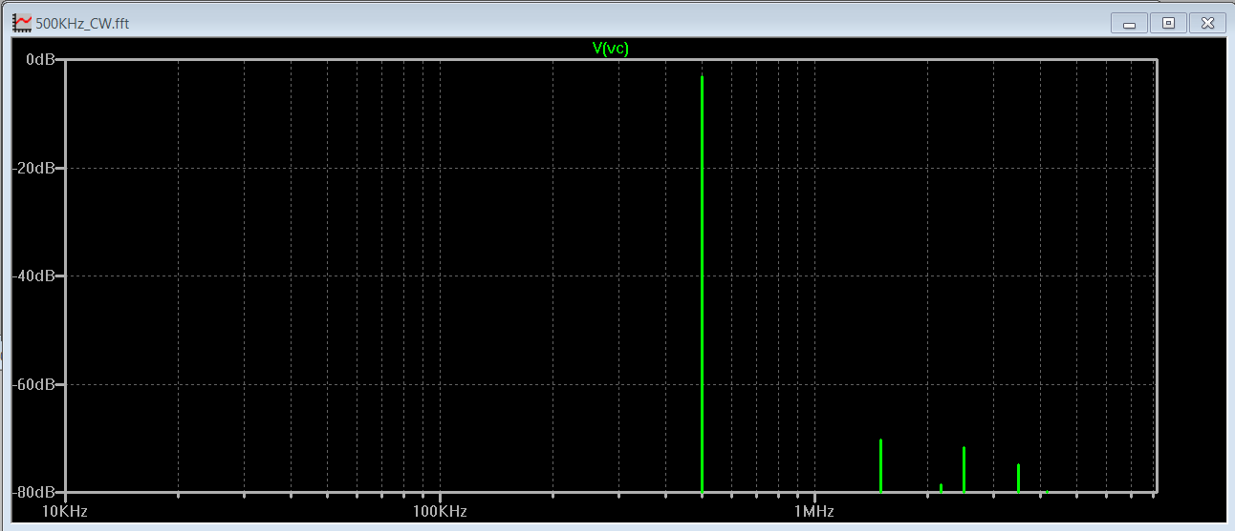
Continuous Waves:
Greater efficiency due to narrow bandwidth.
Produced by:
High-Frequency rotating machinery, e.g.the Alexanderson Alternator
Poulsen Arc Converter
Vacuum-Tube or Solid-State Oscillators
Time Domain ->
Frequency Domain ->

Slide 5
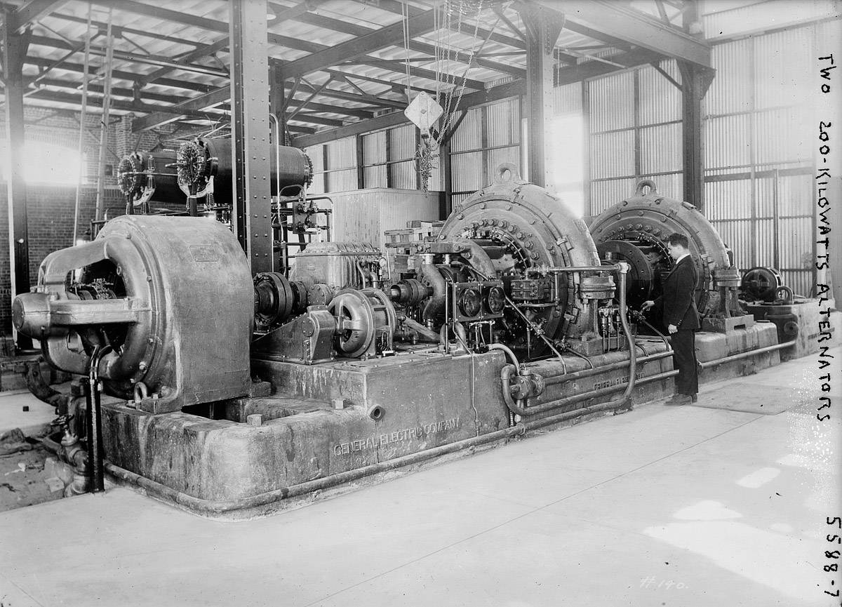
Alexanderson Alternator Continuous-Wave Transmitter
AC Motor (left) turns high-frequency alternator (center) producing 200 KW in the frequency range of 15 – 30 KHz.

Slide 6
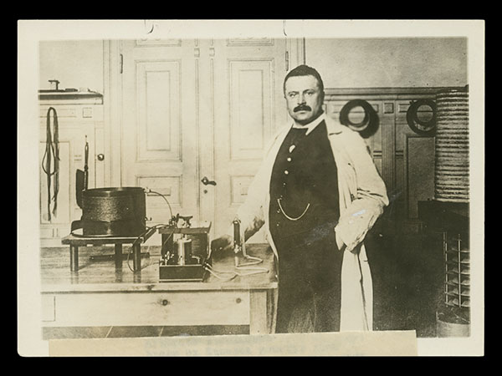
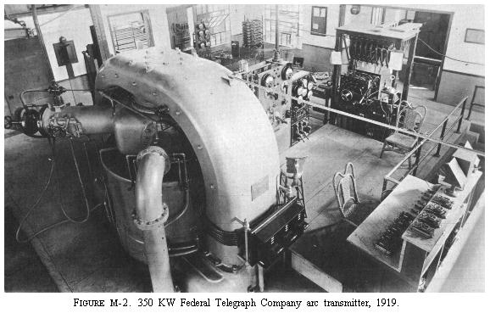
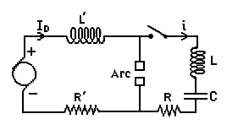
Poulsen Arc Continuous-Wave Transmitter
Vladimir Poulsen with small arc converter.
350 KW Federal Telegraph Co. Arc Transmitter - 1919
The DC arc has negative resistance causing the LC circuit to oscillate.

